Slide 1
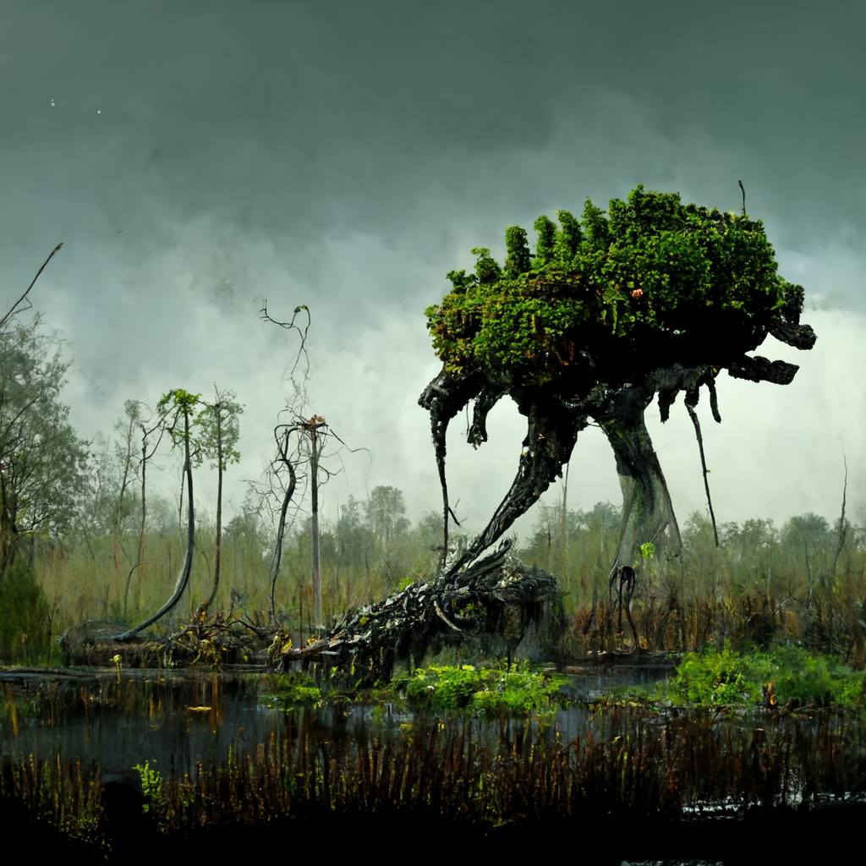
Flora-
4
4
4

Slide 2




4
Floraling
Cultivate, Growth
FRAGMENT
5
5
5

